Slide 1
RL- بالعربي
L02: Markov Decision Processes (MDPs) I (slides from Berkeley CS188)

Slide 2
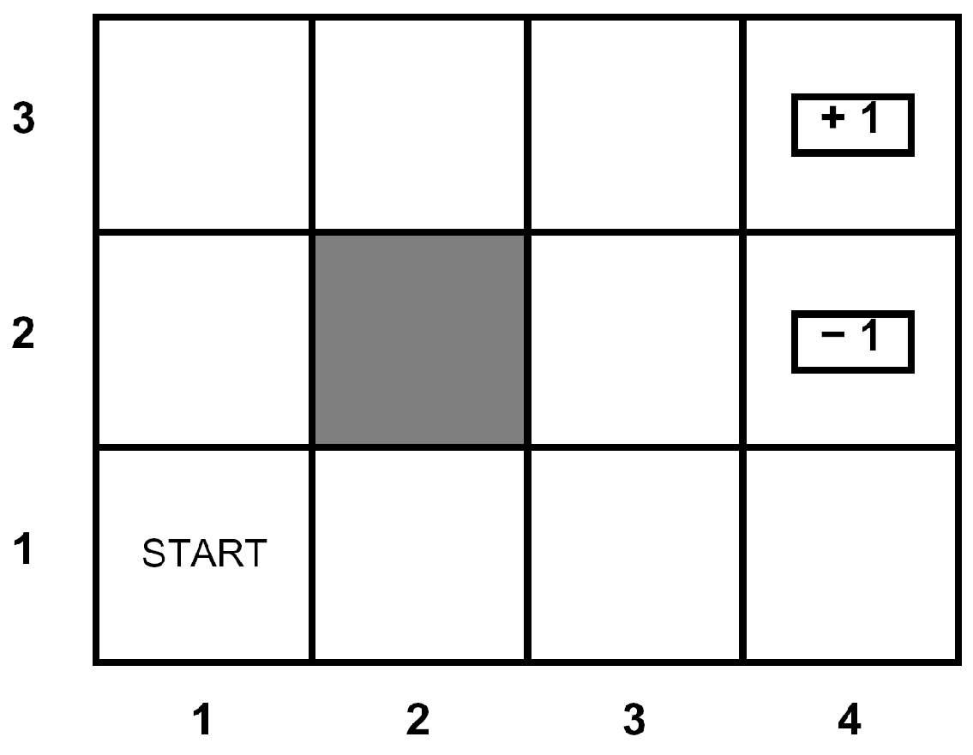
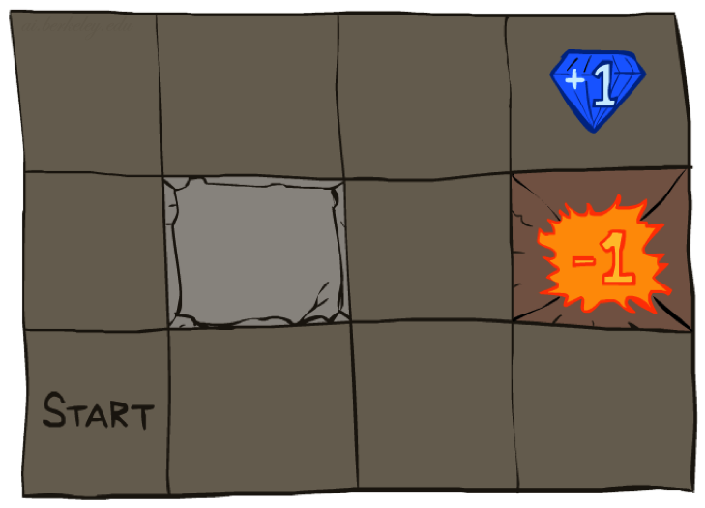




Example: Grid World
A maze-like problem
The agent lives in a grid
Walls block the agent’s path
Noisy movement: actions do not always go as planned
80% of the time, the action North takes the agent North (if there is no wall there)
10% of the time, North takes the agent West; 10% East
If there is a wall in the direction the agent would have been taken, the agent stays put
The agent receives rewards each time step
Small “living” reward each step (can be negative)
Big rewards come at the end (good or bad)
Goal: maximize sum of rewards
Notes:
[cut demo of moving around in grid world program]

Slide 3
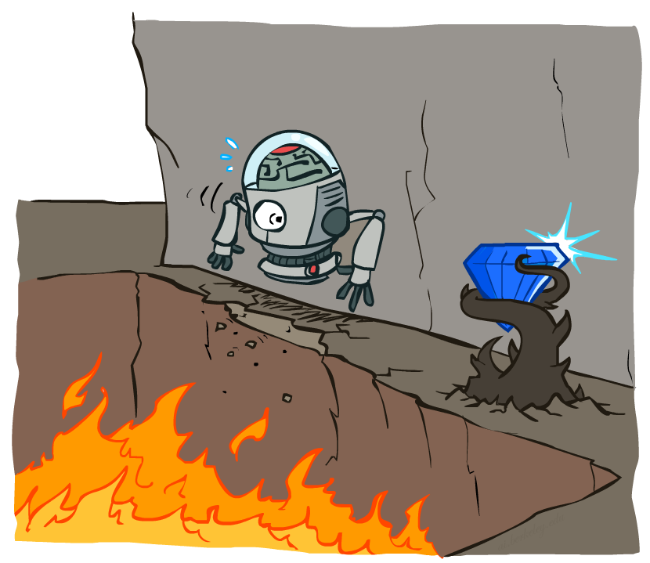
Non-Deterministic Search

Slide 4
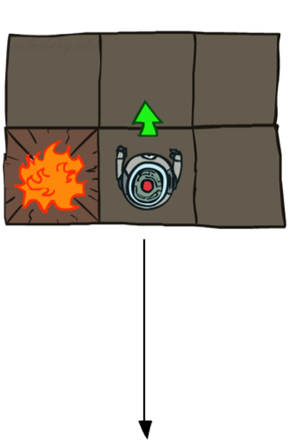
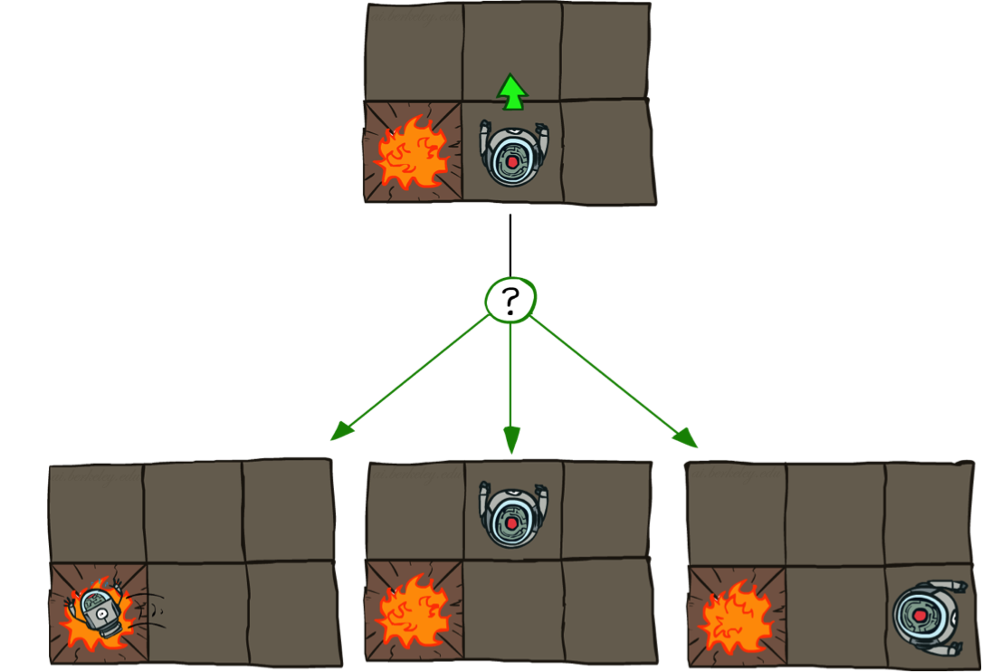
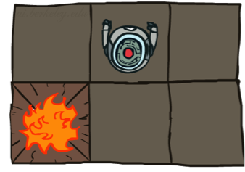
Grid World Actions
Deterministic Grid World
Stochastic Grid World

Slide 5
Markov Decision Processes
An MDP is defined by:
A set of states s ∈ S
A set of actions a ∈ A
A transition function T(s, a, s’)
Probability that a from s leads to s’, i.e., P(s’| s, a)
Also called the model or the dynamics
A reward function R(s, a, s’)
Sometimes just R(s) or R(s’)
A start state
Maybe a terminal state
Notes:
In search problems: did not talk about actions, but about successor functions --- now the information inside the successor function is unpacked into actions, transitions and reward
Write out S, A, example entry in T, entry in R
Reward function different from the book : R(s,a,s’)
In book simpler for equations, but not useful for the projects.
Need to modify expectimax a tiny little bit to account for rewards along the way, but that’s something you should be able to do, and so you can already solve MDP’s (not in most efficient way)

Slide 6
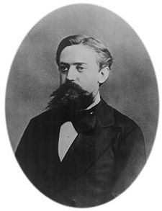

What is Markov about MDPs?
“Markov” generally means that given the present state, the future and the past are independent
For Markov decision processes, “Markov” means action outcomes depend only on the current state
This is just like search, where the successor function could only depend on the current state (not the history)
Andrey Markov (1856-1922)
Notes:
Like search: successor function only depended on current state
Can make this happen by stuffing more into the state;
Very similar to search problems: when solving a maze with food pellets, we stored which food pellets were eaten

Slide 7
Markov Property
S₀
S₁
S_{t-1}
S_{t}
S_{t+1}
...
=
S_{t}
S_{t+1}

Slide 8

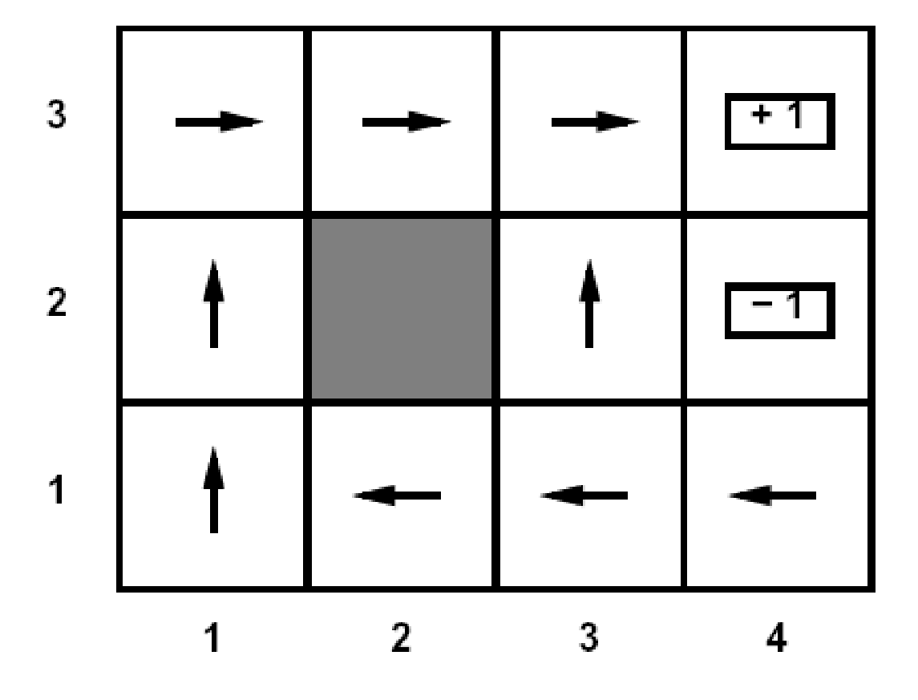
Policies
In deterministic single-agent search problems, we wanted an optimal plan, or sequence of actions, from start to a goal
For MDPs, we want an optimal policy π*: S → A
A policy π gives an action for each state
An optimal policy is one that maximizes expected utility if followed
An explicit policy defines a reflex agent
Optimal policy when R(s, a, s’) = -0.03 for all non-terminals s
Notes:
Dan has a DEMO for this.

Slide 9
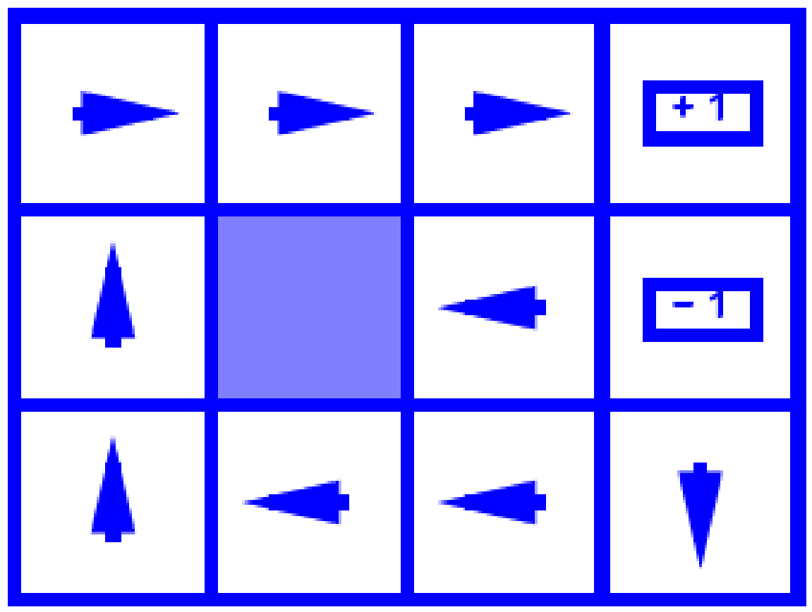
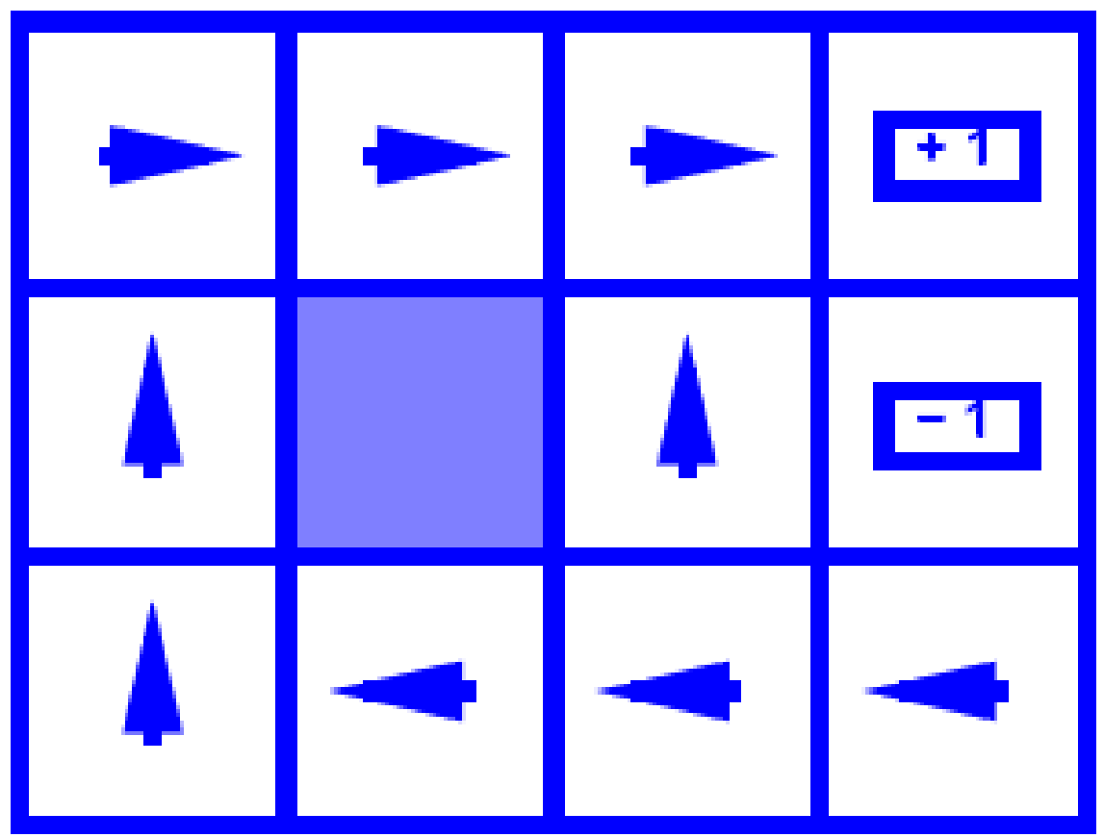
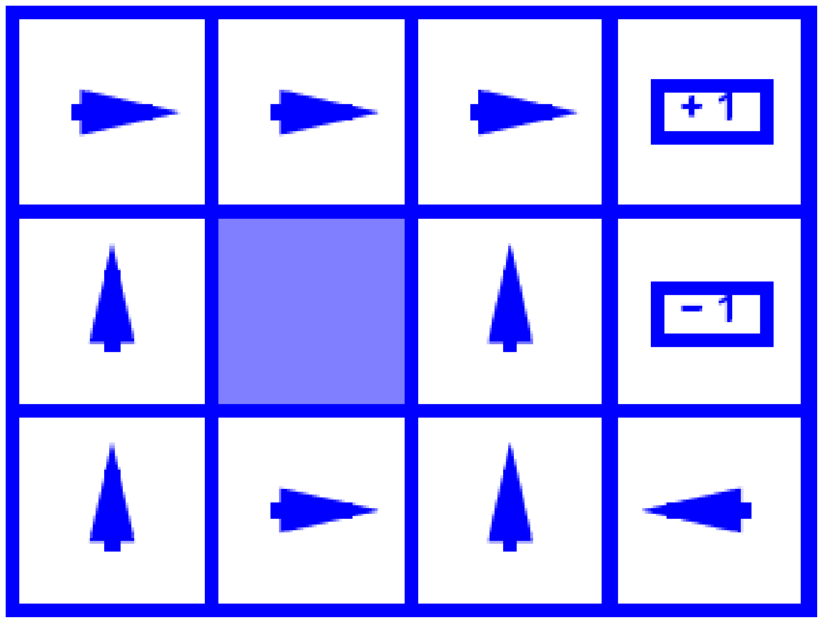
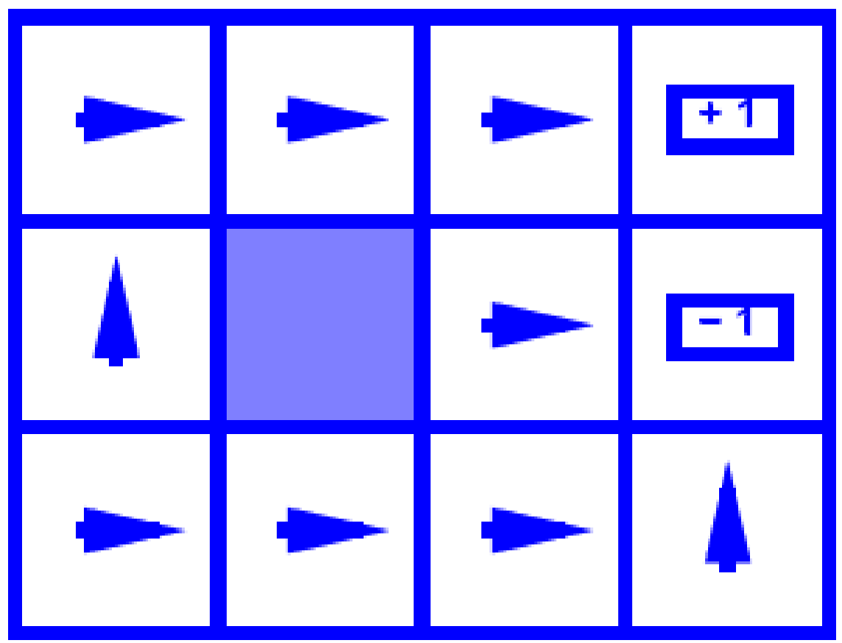
Optimal Policies
R(s) = -0.01
R(s) = -0.03
R(s) = -0.4
R(s) = -2.0
Notes:
R(s) = the “living reward”

Slide 10
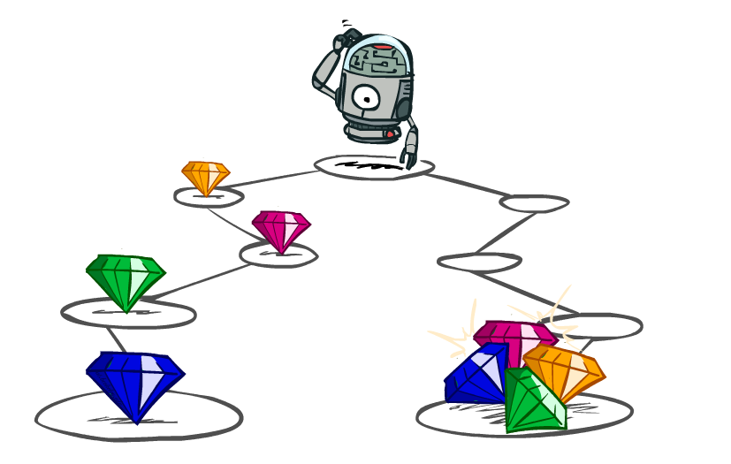
Utilities of Sequences

Slide 11
Utilities of Sequences
What preferences should an agent have over reward sequences?
More or less?
Now or later?
[1, 2, 2]
or
[2, 3, 4]
[0, 0, 1]
or
[1, 0, 0]

Slide 12

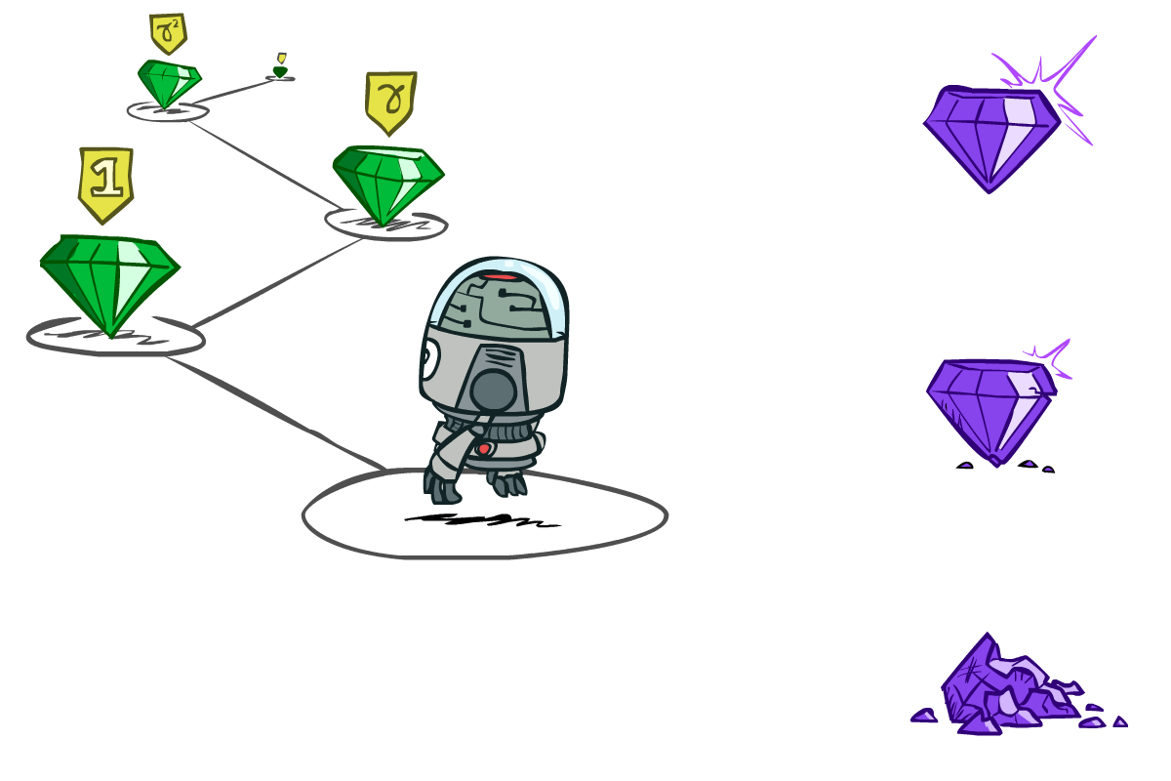

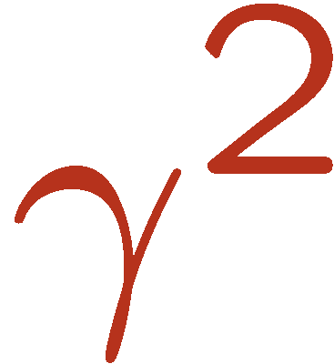

Discounting
It’s reasonable to maximize the sum of rewards
It’s also reasonable to prefer rewards now to rewards later
One solution: values of rewards decay exponentially
Worth Now
Worth Next Step
Worth In Two Steps

Slide 13

Discounting
How to discount?
Each time we descend a level, we multiply in the discount once
Why discount?
Sooner rewards probably do have higher utility than later rewards
Also helps our algorithms converge
Example: discount of 0.5
U([1,2,3]) = 1*1 + 0.5*2 + 0.25*3
U([1,2,3]) < U([3,2,1])
Notes:
Rewards in the future (deeper in the tree) matter less
Interesting: running expectimax, if having to truncate the search, then not losing much; e.g., less then \gamma^d / (1-\gamma)

Slide 14

Quiz: Discounting
Given:
Actions: East, West, and Exit (only available in exit states a, e)
Transitions: deterministic
Quiz 1: For γ = 1, what is the optimal policy?
Quiz 2: For γ = 0.1, what is the optimal policy?
Quiz 3: For which γ are West and East equally good when in state d?
Exit | ← | ← | ← | ←
Exit | ← | ← | → | Exit
10 γ³ = 1γ γ = 0.316
Notes:
Quiz 1: exit - left - left - left - left
Quiz 2: exit - left - left - right - exit
Quiz 3: 10*gamma^2 = 1 , so gamma = 0.316

Slide 15

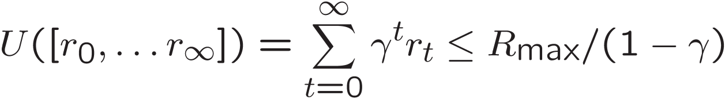
Infinite Utilities?!
Problem: What if the game lasts forever? Do we get infinite rewards?
Solutions:
Finite horizon: (similar to depth-limited search)
Terminate episodes after a fixed T steps (e.g. life)
Gives nonstationary policies (π depends on time left)
Discounting: use 0 < γ < 1
Smaller γ means smaller “horizon” – shorter term focus
Absorbing state: guarantee that for every policy, a terminal state will eventually be reached

Slide 16
Recap: Defining MDPs
Markov decision processes:
Set of states S
Start state s₀
Set of actions A
Transitions P(s’|s,a) (or T(s,a,s’))
Rewards R(s,a,s’) (and discount γ)
MDP quantities so far:
Policy = Choice of action for each state
Utility = sum of (discounted) rewards
s
a
s, a
s,a,s’
s’

